Slide 1
Natural Language Processing for Music Generation
Girish Kumar Adari, Prerna Chander, Varadh Kaushik
CS 6120 - Fall 2023

Slide 2
Introduction
This project aims to explore the synergy between lyrics and music, utilizing NLP to bridge the gap between textual information and musical composition.
The system involves the extraction of sentiment, identification of keywords, and topic modeling to provide a nuanced understanding of the lyrical content. By analyzing and understanding the emotional and thematic aspects of lyrics, the system aims to generate music that is not only technically sound but also emotionally resonant.

Slide 3
Methods: Dataset and Data Pre-Processing
Dataset for this project is sourced from the Lakh MIDI Dataset - collection of MIDI files with instrumental aspects and musical elements of each song
Genius API is utilized to retrieve song lyrics, providing a diverse range of textual data
Spotify API is employed to extract metadata associated with each song, including genres, tempo, and popularity

Slide 4
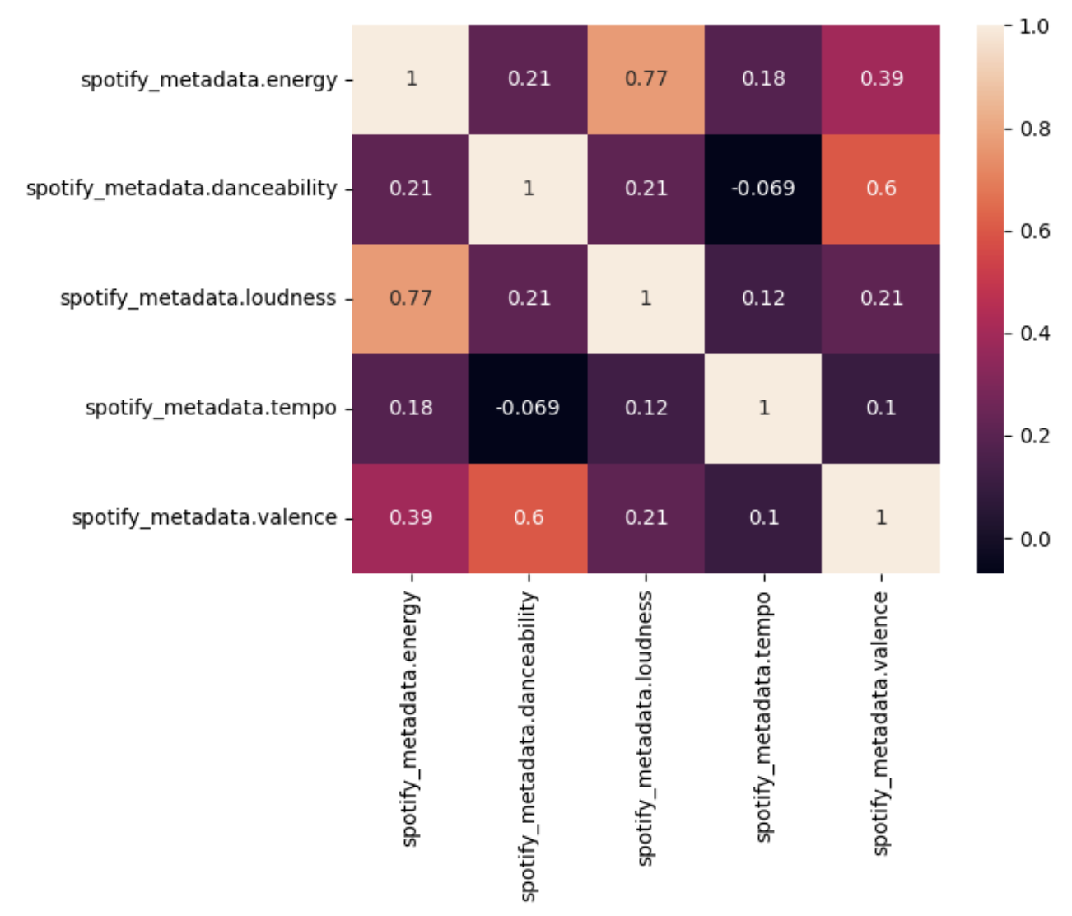
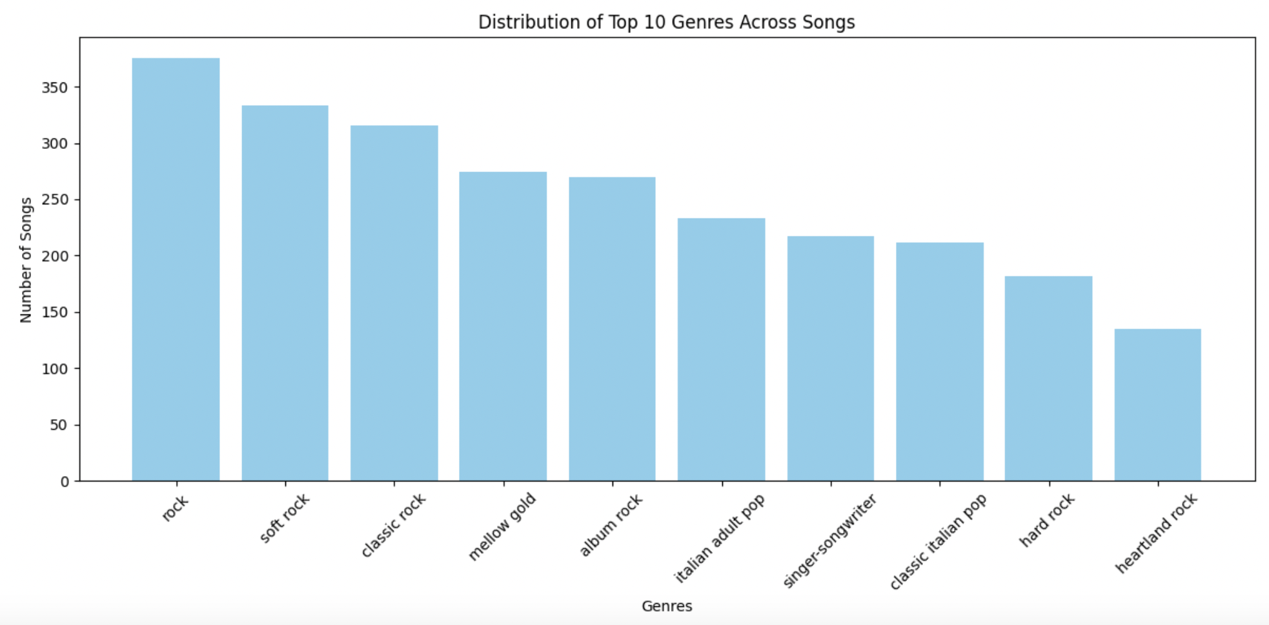
Methods: Exploratory Data Analysis

Slide 5
Methods: Sentiment Analysis and Keyword Extraction
Once the raw lyrics are obtained, the TextBlob library is employed for sentiment analysis. Sentiment analysis provides a quantitative measure of the emotional tone present in each song's lyrics.
The RAKE (Rapid Automatic Keyword Extraction) algorithm is then utilized for keyword extraction. By extracting keywords from the pre-processed lyrics, the system identifies prominent themes, subjects, and emotional undertones within each song.

Slide 6
Methods: Topic Modeling
The Gensim library is utilized to create a corpus from the pre-processed lyrics, and the Latent Dirichlet Allocation (LDA) model is trained on this corpus.
The LDA model assigns topics to the lyrics, providing a structured representation of the underlying themes present in the dataset.
This process allows for a nuanced understanding of the recurring topics that characterize the song lyrics.

Slide 7
Methods: Prompt Construction
The prompt is constructed by combining information from the sentiment analysis, keyword extraction, Spotify metadata, and identified topics. An example is shown in the table below.
Song Title | Artist Name | Sentiment | Keywords | Spotify Metadata | Topics | Prompt
Caught Up In You | .38 Special | Positive (0.206) | ['good love slip away', 'played around enough', 'never wanna get'] | {'energy': 0.681, 'acousticness': 0.0229, 'danceability': 0.425, 'instrumentalness': 0.000219, 'liveness': 0.0543, 'speechiness': 0.0316, 'loudness': -8.604, 'tempo': 131.011, 'time_signature': 4, 'valence': 0.933, 'genre': ['album rock', 'classic rock', 'country rock', 'glam metal', 'hard rock'], 'popularity': 65} | Love, Like, Know, Say, Wanna | ".38 Special's song 'Caught Up In You' has a positive tone and includes themes like good love slip away, played around enough, and belongs to genres such as album rock, classic rock, with a tempo of around 131.011 BPM. The lyrics often reflect topics such as love, like, know, say, wanna."

Slide 8
Methods: Using the Facebook MusicGen Models for Music Generation
MusicGen is a unified Language Model designed with a single-stage transformer LM combined with efficient token interleaving patterns. MusicGen can be conditioned on textual descriptions or melodic features.
We used two pre-trained text-to-music models for comparison purposes: facebook/musicgen-small (300M model) and facebook/musicgen-medium (1.5B model).
We opted for a model size that aligns with our available GPU resources, balancing computational efficiency and performance.

Slide 9

Results and Analysis
Original Piece: Musette in D major, BWV Anh. 126
Prompt generated: "Bach Johann Sebastian's song 'Musette BWV Anh.126' has a neutral tone and belongs to genres such as baroque, classical with a tempo of around 170.949 BPM."
Small Model Generated Piece [300M]:
Medium Model Generated Piece [1.5B]:

Slide 10
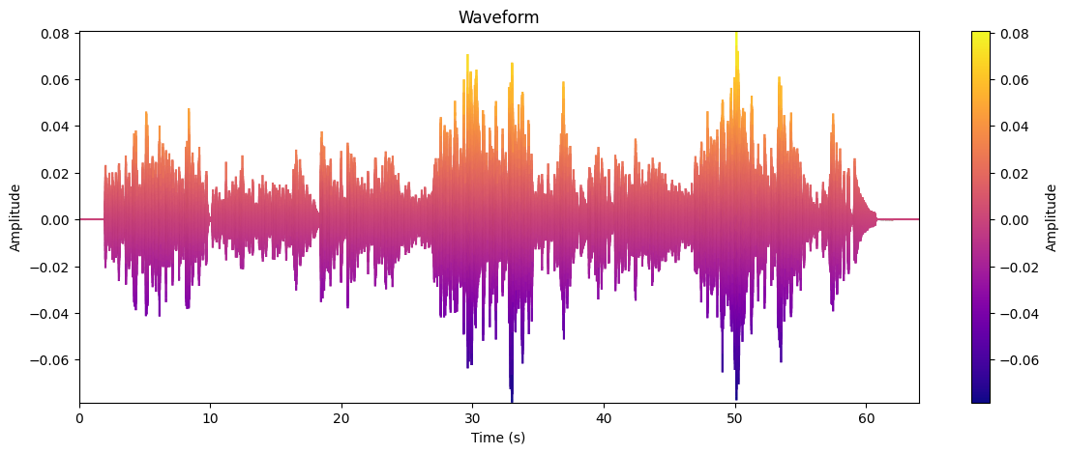
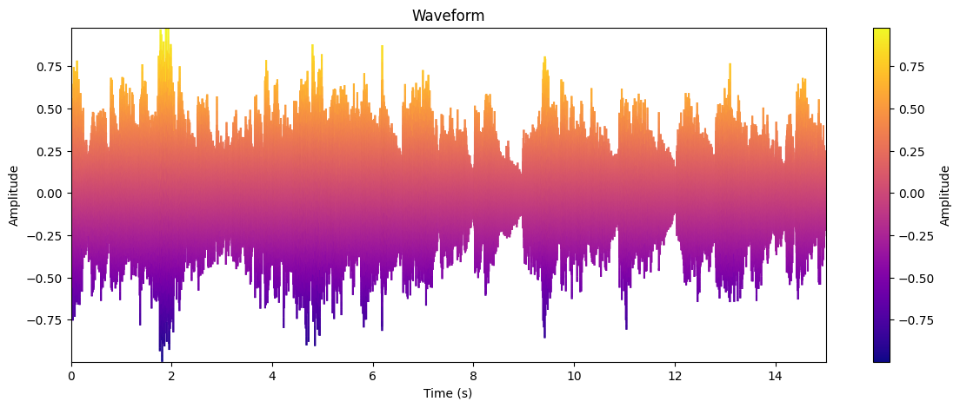
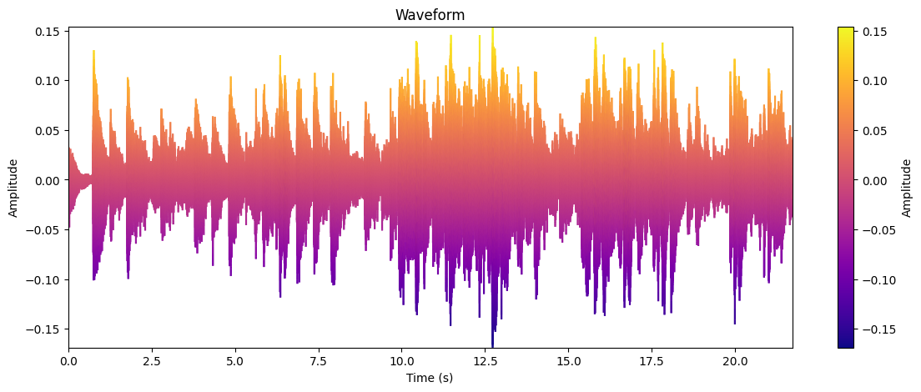
Original Piece:
File: Musette_BWV_Anh.126.wav
Tempo: 170.95 BPM
Medium model:
File: Untitled5.wav
Tempo: 152.00 BPM
Small model:
File: output_6.wav
Tempo: 117.45 BPM

Slide 11
Future Work
By using the prompts along with the midi data, we can further tune the pre-trained MusicGen models to help to improve performance by avoiding overfitting and enhancing the model's ability to generate diverse and high-quality music. We provided the initial code we worked on - parsed the midi files and combined the data with the prompt tokens, split the data into train (80%) and test (20%) and provided the input to the facebook/musicgen-small model. However, due to complexity and dynamic nature of fine-tuning, additional time and extended exploration is needed.
While the current model is effective within these constraints, it is limited in its capacity to capture more intricate patterns and nuances inherent in complex music compositions. Given additional GPU resources, we can delve into facebook/musicgen-large. The larger models are equipped to handle a broader range of musical intricacies.
Notes:
Limitations of the Current Model:
"While the current model has shown effectiveness within its operational scope, it faces limitations. It struggles to capture the intricate patterns and nuances that are key in complex musical compositions."
Introduction to Future Work:
"In our next steps, we aim to refine our approach by integrating midi data with textual prompts, into the capabilities of pre-trained MusicGen models.
Current Progress and Challenges:
"We've made initial strides by parsing midi files and combining them with prompt tokens. This processed data was split into a training set, which constitutes 80%, and a test set covering the remaining 20%. We've fed this data into the facebook/musicgen-small model. However, the complexity of fine-tuning these models necessitate additional time and a more extensive exploration phase."
Exploring Advanced Opportunities with Enhanced Resources:
"Our future endeavors include harnessing more powerful resources. With increased GPU capacity, we plan to experiment with the more robust facebook/musicgen-large model[3.3B]. These larger models have the potential to understand and replicate a wider array of musical intricacies, pushing the boundaries of what our AI can achieve in music generation."

Slide 12
Conclusions
This project has showcased the potential of leveraging NLP techniques to enhance the creative process. The adoption of NLP components, including sentiment analysis, keyword extraction, and topic modeling, has proven to be a strategic approach in constructing prompts for the text-to-music generation models.
The results of our experiments with the Facebook MusicGen models, particularly the medium-sized model, have demonstrated success in terms of tempo accuracy, spectral features, and overall fluidity.
Looking ahead, the potential for fine-tuning the MusicGen models based on these NLP-informed prompts opens avenues for specialization in various domains and genres. Additionally, the scalability of model performance relative to size highlights the adaptability and efficiency of such models in music generation tasks.
The harmonious collaboration between language processing and musical creativity offers exciting prospects for the future of AI-driven music composition.
Notes:
NLP's Role in Music Generation:
"We've demonstrated how NLP techniques like sentiment analysis and keyword extraction effectively enhance AI music generation, creating more targeted prompts for our models."
Experiment Achievements:
"Our work with Facebook's medium-sized MusicGen model has shown promising results in tempo accuracy and musical fluidity."
Future Potential and Scalability:
"The future for fine-tuning MusicGen models with NLP-informed prompts, suggests potential for genre-specific advancements and model adaptability."
Final Thoughts:
"This project highlights the exciting possibilities at the intersection of language processing and musical creativity, paving the way for innovative AI-driven music composition."

